Slide 1

SOURCE.
A distributed reputation platform enabling financial risk management for the world’s unbanked
Created By: Rika Sukenik, Zhenting Zhou, Philip Glazman

Slide 2
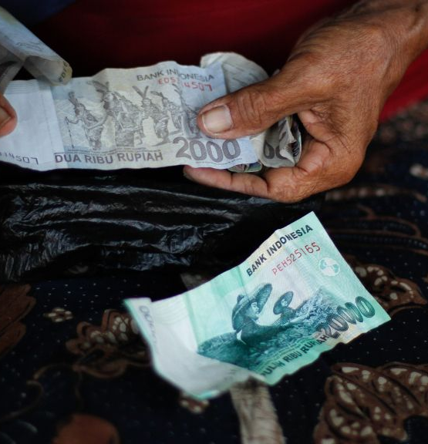
THE PROBLEM
Two billion people in the world do not have a bank account!
Why?
Having too little money to keep in an account
Cost and distance to a bank
Lack of documentation and distrust in financial system
No bank account = no credit score = no loans = no upward mobility
An emergency event like crop damage can financially wipe out a person and a family
Notes:
2 b people don’t have a bank account Therefore, don’t have access to the credit market
What would help is a system based on reputation Web of trust

Slide 3
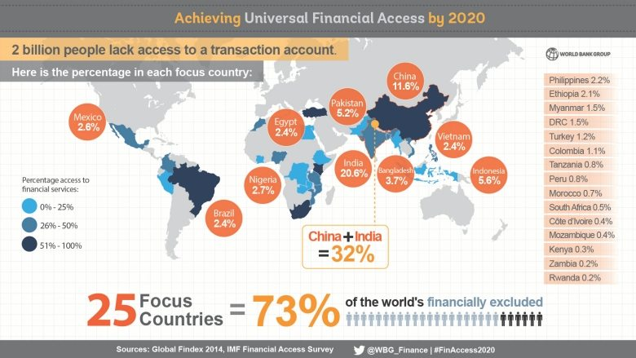

Slide 4
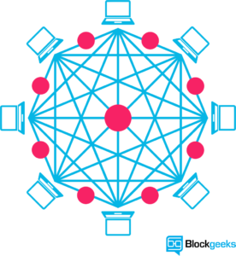
THE SOLUTION
An alternative data model – based on reputation – to assess an individual’s credit worthiness
Technical details:
Protocol layer – Interoperable ERC 721 (non-fungible) token
Application Layer (business layer) – ability to extract meaningful information from reputation information and create reports
Why Blockchain?
No central authority has ability to restrict access, shut down network, etc.
Network is open to any and all
Complete transparency to reputation information
1 stop shop: ERC 721 token allows for interoperability across all lenders.
Notes:
Decentralized, public platform that enables reputation to be crowd sourced. Using Ethereum because of it’s smart contract functionality, which we are using to mint tokens aka endorsements.

Slide 5
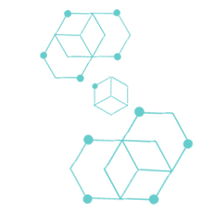



SOURCE
HealthScore - ask endorser to judge health choices of individual TrustScore - ask endorser to judge the trustworthiness of the individal PatienceScore - ask endorser to judge the patience/delayed gratification of the individual
SOURCE score
Access QR Code
Analytics and Reporting
A global database of SOURCE scores is stored publicly
Select metadata and mint ERC 720 token
Complete reputation questions
Algorithm computes SOURCE score
No PII is stored
All data is encrypted
Slice and dice data to create meaningful reports
2
1
3
Notes:
3 types of questions. Through our research, we have found that these data points are indicative of high credit scores

Slide 6

SOURCE
HealthScore - ask endorser to judge health choices of individual TrustScore - ask endorser to judge the trustworthiness of the individal PatienceScore - ask endorser to judge the patience/delayed gratification of the individual
SOURCE score
Access QR Code
Analytics and Reporting
A global database of SOURCE scores is stored publicly
Select metadata and mint ERC 720 token
Complete reputation questions
Algorithm computes SOURCE score
No PII is stored
All data is encrypted
Slice and dice data to create meaningful reports
2
1
3

Slide 7
SOURCE
HealthScore - ask endorser to judge health choices of individual TrustScore - ask endorser to judge the trustworthiness of the individal PatienceScore - ask endorser to judge the patience/delayed gratification of the individual
SOURCE score
Access QR Code
Analytics and Reporting
A global database of SOURCE scores is stored publicly
Select metadata and mint ERC 720 token
Complete reputation questions
Algorithm computes SOURCE score
No PII is stored
All data is encrypted
Slice and dice data to create meaningful reports
2
1
3

Slide 8
SOURCE
HealthScore - ask endorser to judge health choices of individual TrustScore - ask endorser to judge the trustworthiness of the individal PatienceScore - ask endorser to judge the patience/delayed gratification of the individual
SOURCE score
Access QR Code
Analytics and Reporting
A global database of SOURCE scores is stored publicly
Select metadata and mint ERC 720 token
Complete reputation questions
Algorithm computes SOURCE score
No PII is stored
All data is encrypted
Slice and dice data to create meaningful reports
2
1
3

Slide 9
